Slide 1

Christ Loves His Church
Ephesians 5:25
Notes:
Eddie Williams ~ August 19, 2012 (Eloy)
November 5. 2017 (Eloy)
October 7, 2018 (Eloy)
June 1, 2025 (Eloy)
April 4, 2026

Slide 2
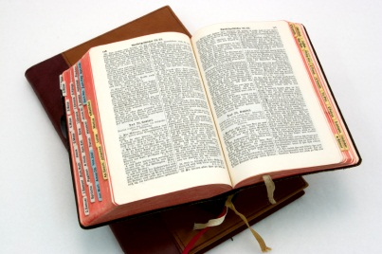
TEXT: Ephesians 5:25
Husbands, love your wives, even as Christ also loved the church, and gave himself for it;

Slide 3
Seven Evidences of Christ’s Love
Christ Feeds and Cares For His Church
Christ Strengthens the Inner Man
Christ Helps His Church When They Are Tempted
Christ Gives His Church Mercy and Grace When They Are in Need

Slide 4
Seven Evidences of Christ’s Love
Jesus Gives Rest to Those Who Are in His Church
Jesus’ Love for His Church is to be Seen in His Church by How They Love One Another
Christ Knows Exactly What’s Going on in His Church and He Will Deal With It

Slide 5
Point #1: Christ Feeds and Cares For His Church ~ Ephesians 5:29
For no man ever yet hated his own flesh; but nourisheth and cherisheth it, even as the Lord the church:

Slide 6
Point #2: Christ Strengthens the Inner Man ~ Ephesians 3:16-21
16 That he would grant you, according to the riches of his glory, to be strengthened with might by his Spirit in the inner man;

Slide 7
Ephesians 3:16-21
17 That Christ may dwell in your hearts by faith; that ye, being rooted and grounded in love,
18 May be able to comprehend with all saints what is the breadth, and length, and depth, and height;

Slide 8
Ephesians 3:16-21
19 And to know the love of Christ, which passeth knowledge, that ye might be filled with all the fulness of God. 20 Now unto him that is able to do exceeding abundantly above all that we ask or think,

Slide 9
Ephesians 3:16-21
according to the power that worketh in us, 21 Unto him be glory in the church by Christ Jesus throughout all ages, world without end. Amen.

Slide 10
Point #3: Christ Helps His Church When They Are Tempted ~ Hebrews 2:16-18
16 That he would grant you, according to the riches of his glory,

Slide 11
Hebrews 2:16-18
to be strengthened with might by his Spirit in the inner man; 17 Wherefore in all things it behoved him to be made like unto his brethren, that he might be a merciful and faithful high priest in things pertaining to God,

Slide 12
Hebrews 2:17-18
to make reconciliation for the sins of the people. 18 For in that he himself hath suffered being tempted, he is able to succour them that are tempted.

Slide 13
Point #4: Christ Gives His Church Mercy and Grace When They Are in Need~ Hebrews 4:14-16
14 Seeing then that we have a great high priest, that is passed into the heavens, Jesus the Son of God,

Slide 14
Hebrews 4:14-16
let us hold fast our profession. 15 For we have not an high priest which cannot be touched with the feeling of our infirmities; but was in all points tempted like as we are, yet without sin.

Slide 15
Hebrews 4:14-16
16 Let us therefore come boldly unto the throne of grace, that we may obtain mercy, and find grace to help in time of need.

Slide 16
Point #5: Jesus Gives Rest to Those Who Are in His Church~ Matthew 11:28-30
28 Come unto me, all ye that labour and are heavy laden, and I will give you rest.

Slide 17
Matthew 11:28-30
29 Take my yoke upon you, and learn of me; for I am meek and lowly in heart: and ye shall find rest unto your souls.
30 For my yoke is easy, and my burden is light.

Slide 18
Point #6: Jesus’ Love for His Church is to be Seen in His Church by How They Love One Another ~ I John 3:10-11
10 In this the children of God are manifest, and the children of the devil:

Slide 19
I John 3:10-11
whosoever doeth not righteousness is not of God, neither he that loveth not his brother.

Slide 20
I John 3:10-11
11 For this is the message that ye heard from the beginning, that we should love one another.

Slide 21
Point #7: Christ Knows Exactly What’s Going on in His Church and He Will Deal With It ~ Revelation 2:2 / 2:13
2 I know thy works, and thy labour, and thy patience,

Slide 22
Revelation 2:2
and how thou canst not bear them which are evil: and thou hast tried them which say they are apostles, and are not, and hast found them liars:

Slide 23
Revelation 2:13
I know thy works, and where thou dwellest, even where Satan's seat is: and thou holdest fast my name, and hast not denied my faith,

Slide 24
Revelation 2:13
even in those days wherein Antipas was my faithful martyr, who was slain among you, where Satan dwelleth.

Slide 25

…that Christ died for our sins according to the scriptures; And that he was buried, and that he rose again the third day according to the scriptures:

Slide 26
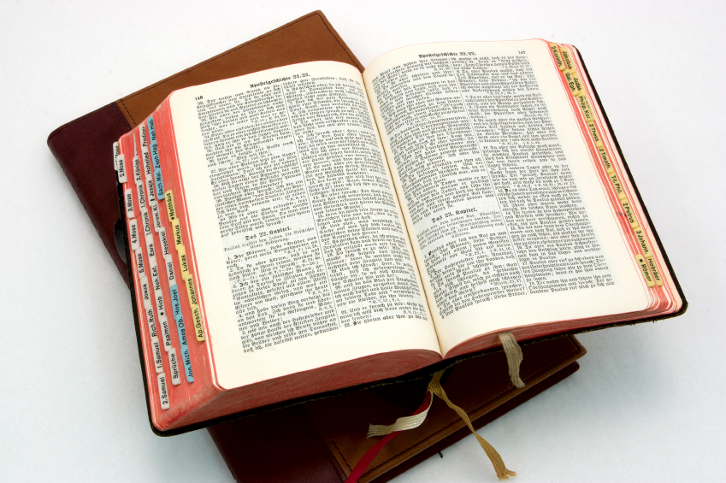
Hear: Romans 10:17
So then faith cometh by hearing, and hearing by the word of God.

Slide 27
Believe: Hebrews 11:6
But without faith it is impossible to please him: for he that cometh to God must believe that he is, and that he is a rewarder of them that diligently seek him.

Slide 28
Repent: Luke 13:3
I tell you, Nay: but, except ye repent, ye shall all likewise perish.

Slide 29
Confess: Matthew 10:32-33
32 Whosoever therefore shall confess me before men, him will I confess also before my Father which is in heaven.
33 But whosoever shall deny me before men, him will I also deny before my Father which is in heaven.

Slide 30
Baptize: Acts 22:16
And now why tarriest thou? arise, and be baptized, and wash away thy sins, calling on the name of the Lord.

